Slide 1
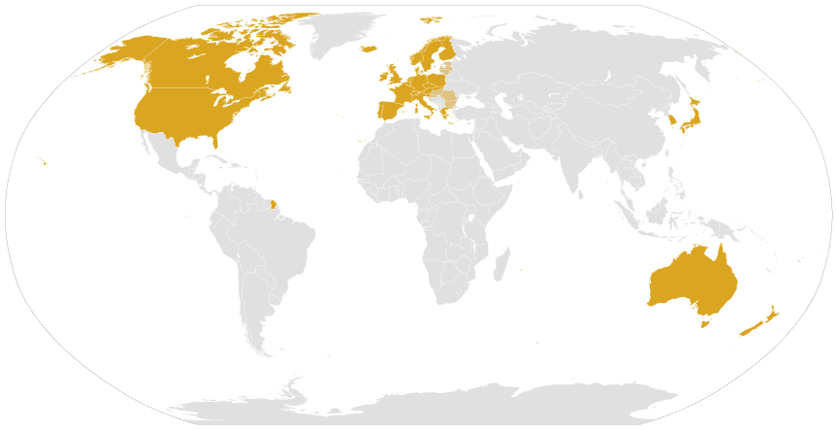
GNF Conference, Energy and Water Solutions in Sub Saharan Africa
Modern Development Cooperation Between Europe and Africa
Murefu Barasa, EED Advisory Limited
Radolfzell, Germany: October 16-17 2014

Slide 2

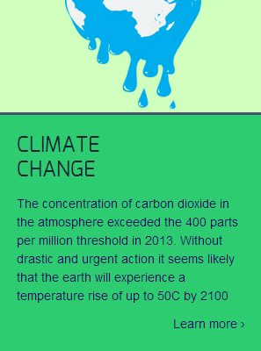


Introduction to EED Advisory
EED is an advisory firm with services offerings in the energy and environment space delivered through four practice lines:
We aspire to be a premier solutions center
1
2
3
4
Notes:
Main motivation is to solve problems through entreprise

Slide 3









Introduction to EED Advisory: Clients

Slide 4

Introduction to EED Advisory: EAR
http://www.eedadvisory.com/resources/energy-access-review/
Notes:
To become a leading local voice on local energy issues in the region

Slide 5
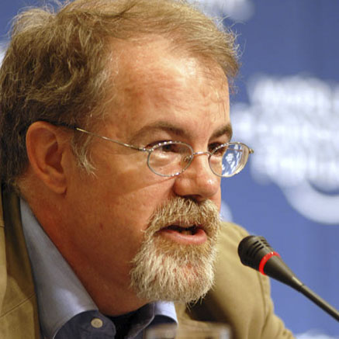
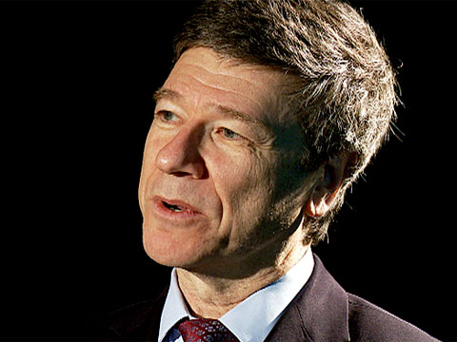
The Tale of Two Professors…
“… the rich need to invest enough so that these countries can get their foot on the economic ladder.”
“…the West’s efforts to aid the rest have done so much ill and so little good.”
Prof. William Easterly,
New York University,
“Whiteman’s burden”
Prof. Jeffrey Sachs,
Columbia University,
“End of Poverty”
Picture credits: http://www.aspenideas.org and http://www.guardian.com/
Notes:
Personal opinion: It is not the anyone else’s responsibility to assist Africa

Slide 6
Current Cooperation in Numbers
Source: OECD (2014) Development Statistics at a Glance: Africa

Slide 7
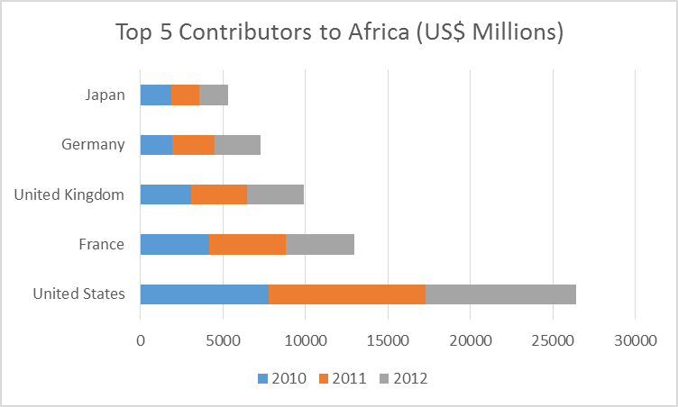
Current Cooperation in Numbers
Source: OECD (2014) Development Statistics at a Glance: Africa

Slide 8
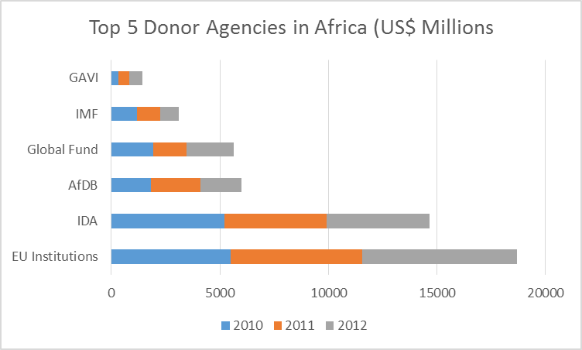
Current Cooperation in Numbers
Source: OECD (2014) Development Statistics at a Glance: Africa
Notes:
GAVI – Global Vaccine Alliance

Slide 9
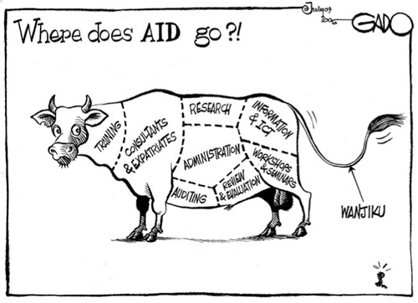
Current Nature of Cooperation
Top down initiatives e.g. green growth strategies, mini-grids, national climate change legislation.
Tethered assistance e.g. technical assistance, equipment supply, service provision, leading to general skepticism

Slide 10

Current Nature of Cooperation
Opportunities for experimental blue-sky initiatives that results in great successes e.g. investment in the geothermal exploration in Kenya in the 1950s and 1960s

Slide 11
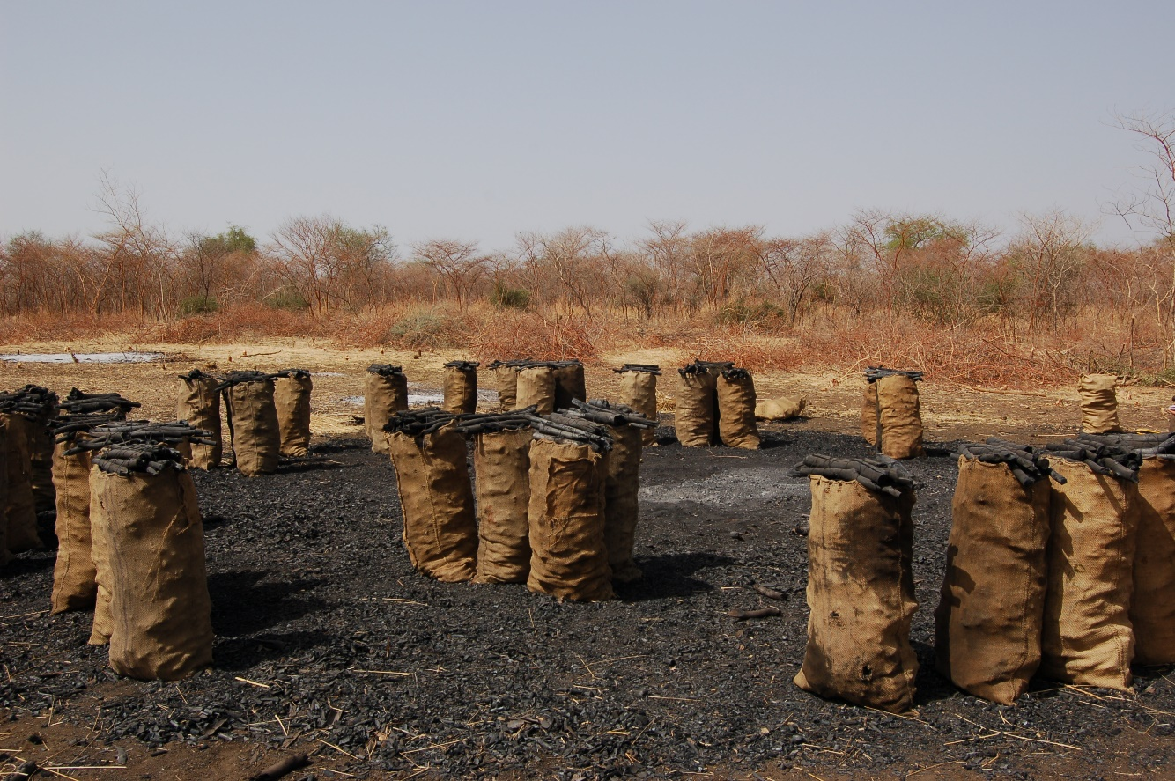
Current Nature of Cooperation
Driven by “crisis narratives” and trends e.g. woodfuel crisis of the late 1970s, briquette for charcoal, current discourse on mini-grids
Source: http://www.postconflict.unep.ch
Notes:
Usual suspects include lack of capacity, policy gaps…
Give the BEL example

Slide 12
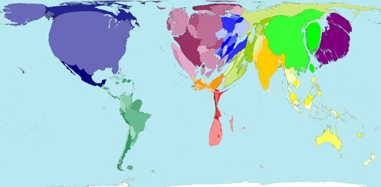
Cooperation in the Energy Sector
An energy starved continent…
Source: http://www.worldmapper.org/display.php?selected=117
Notes:
Not just statistics, give examples

Slide 13
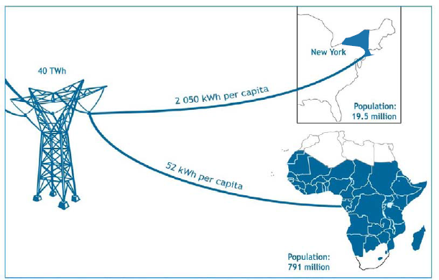
Cooperation in the Energy Sector
Total Electricity Use Per Year
Source: International Energy Agency (2010)

Slide 14
Cooperation in the Energy Sector
Stylized Preference of Electricity Generation Options
Source: EED Advisory (2014) Energy Access Review QTR 3
Notes:
Climate change mitigation push with limited support and waning commitments to meaningfully mitigate
CIF to Uganda = US$ 50 million
Funds allocate to deal with flooding damage in Germany in 2013 = US 10.9 B. Total funds allocated to all developing countries to deal with adaptation since 2003 = US 2.8B
Discovery of fossil fuels: coal and natural gas

Slide 15

Three Suggestions
1. Not substituting aid with trade, but targeting aid that spurs trade and entrepreneurship
Is it commercially sustainable?

Slide 16

Three Suggestions
2. Cultivate peer to peer relations: Most people are moving away from the “West is to blame” notion

Slide 17
Three Suggestions
Reorient the feedback loop: Decision making power to the recipients countries
Current Model: Donors allocates support then select Agencies
Donors
Agencies
Recipients
Proposed Model: Donors allocates support then Recipients select Agencies
Donors
Recipients
Agencies
Notes:
Example of the private sector e.g. apple products e.g. macbook air versus ipads

Slide 18
The Tale of Two Professors…
“… the rich need to invest enough so that these countries can get their foot on the economic ladder.”
“…the West’s efforts to aid the rest have done so much ill and so little good.”
Prof. William Easterly,
New York University,
“Whiteman’s burden”
Prof. Jeffrey Sachs,
Columbia University,
“End of Poverty”
Picture credits: http://www.aspenideas.org and http://www.guardian.com/
Notes:
Emotional seesaw swinging from inspiration to despair
There are many positive steps but we really do need a leap > in 10 years from less than 5% to 97% with telephones; a few thousands with bank accounts to millions in less than a year through Mshwari
We will see that leap in this generation

Slide 19
Thank You!

